Slide 1
Ohio Counseling Association
Awards Reception & Ceremony 2022

Slide 2
Winter 2022
Summer 2022
Fall 2022
Amanda Shuluga
Angel Lacey
Ann Marie Walker
Anne Lange
Carrie George
Christina Scott
Christine McCrone
Courtney Montanye
Erica Ogletree
Hope Hornish
Jason Decker
Joshua Stanley
Katherine Caputo
Kelly Bylewski
Kristin Curran
Kylena France
Lauren Baker
Leah Wood
Mandy Reber
Mykka Gabriel
Richa Bhatia
Shazia Naurin
Tara Hill
Kailey Bradley
Natalie Thornberry
Caroline Griffith
Celena Tunila
Michelle Norris
Claire McMahon
Christin Fontes
Nicolas Smith
Amanda Cole
Kali McQueen
Mason Coyle
Don Allensworth-Davies
Kubra Civan
Stacy Studer
Rosie Bauder
Janet Kempf
David Wamsley
Stephanie Konesky
Helen Green-Esterly
Nina Talley
Kalesha Jenkins
Jocee Janicki
Lindsay Heckman
Laci Carsey
Rebecca Smith
Staci Tessmer
Sally Hackett

Slide 3
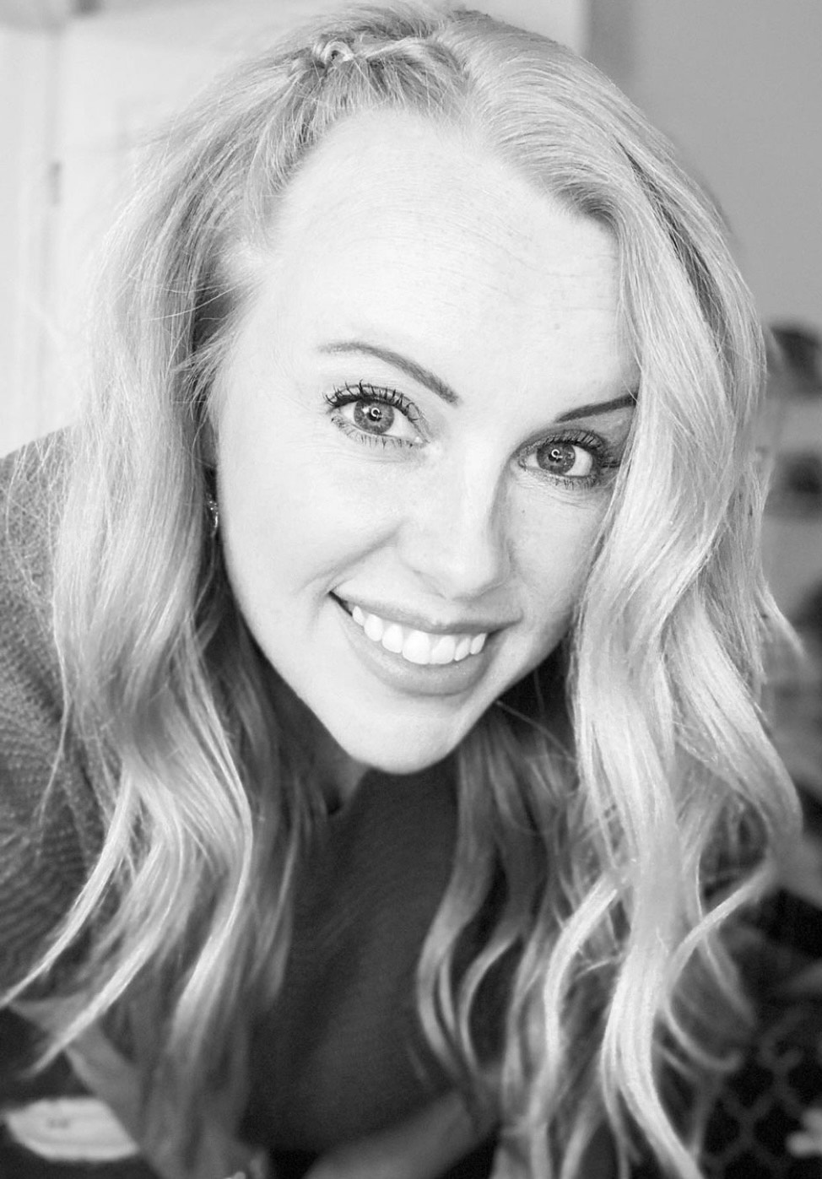
Charles “Chuck” Weaver Award
Dr. Marisa Cargill

Slide 4
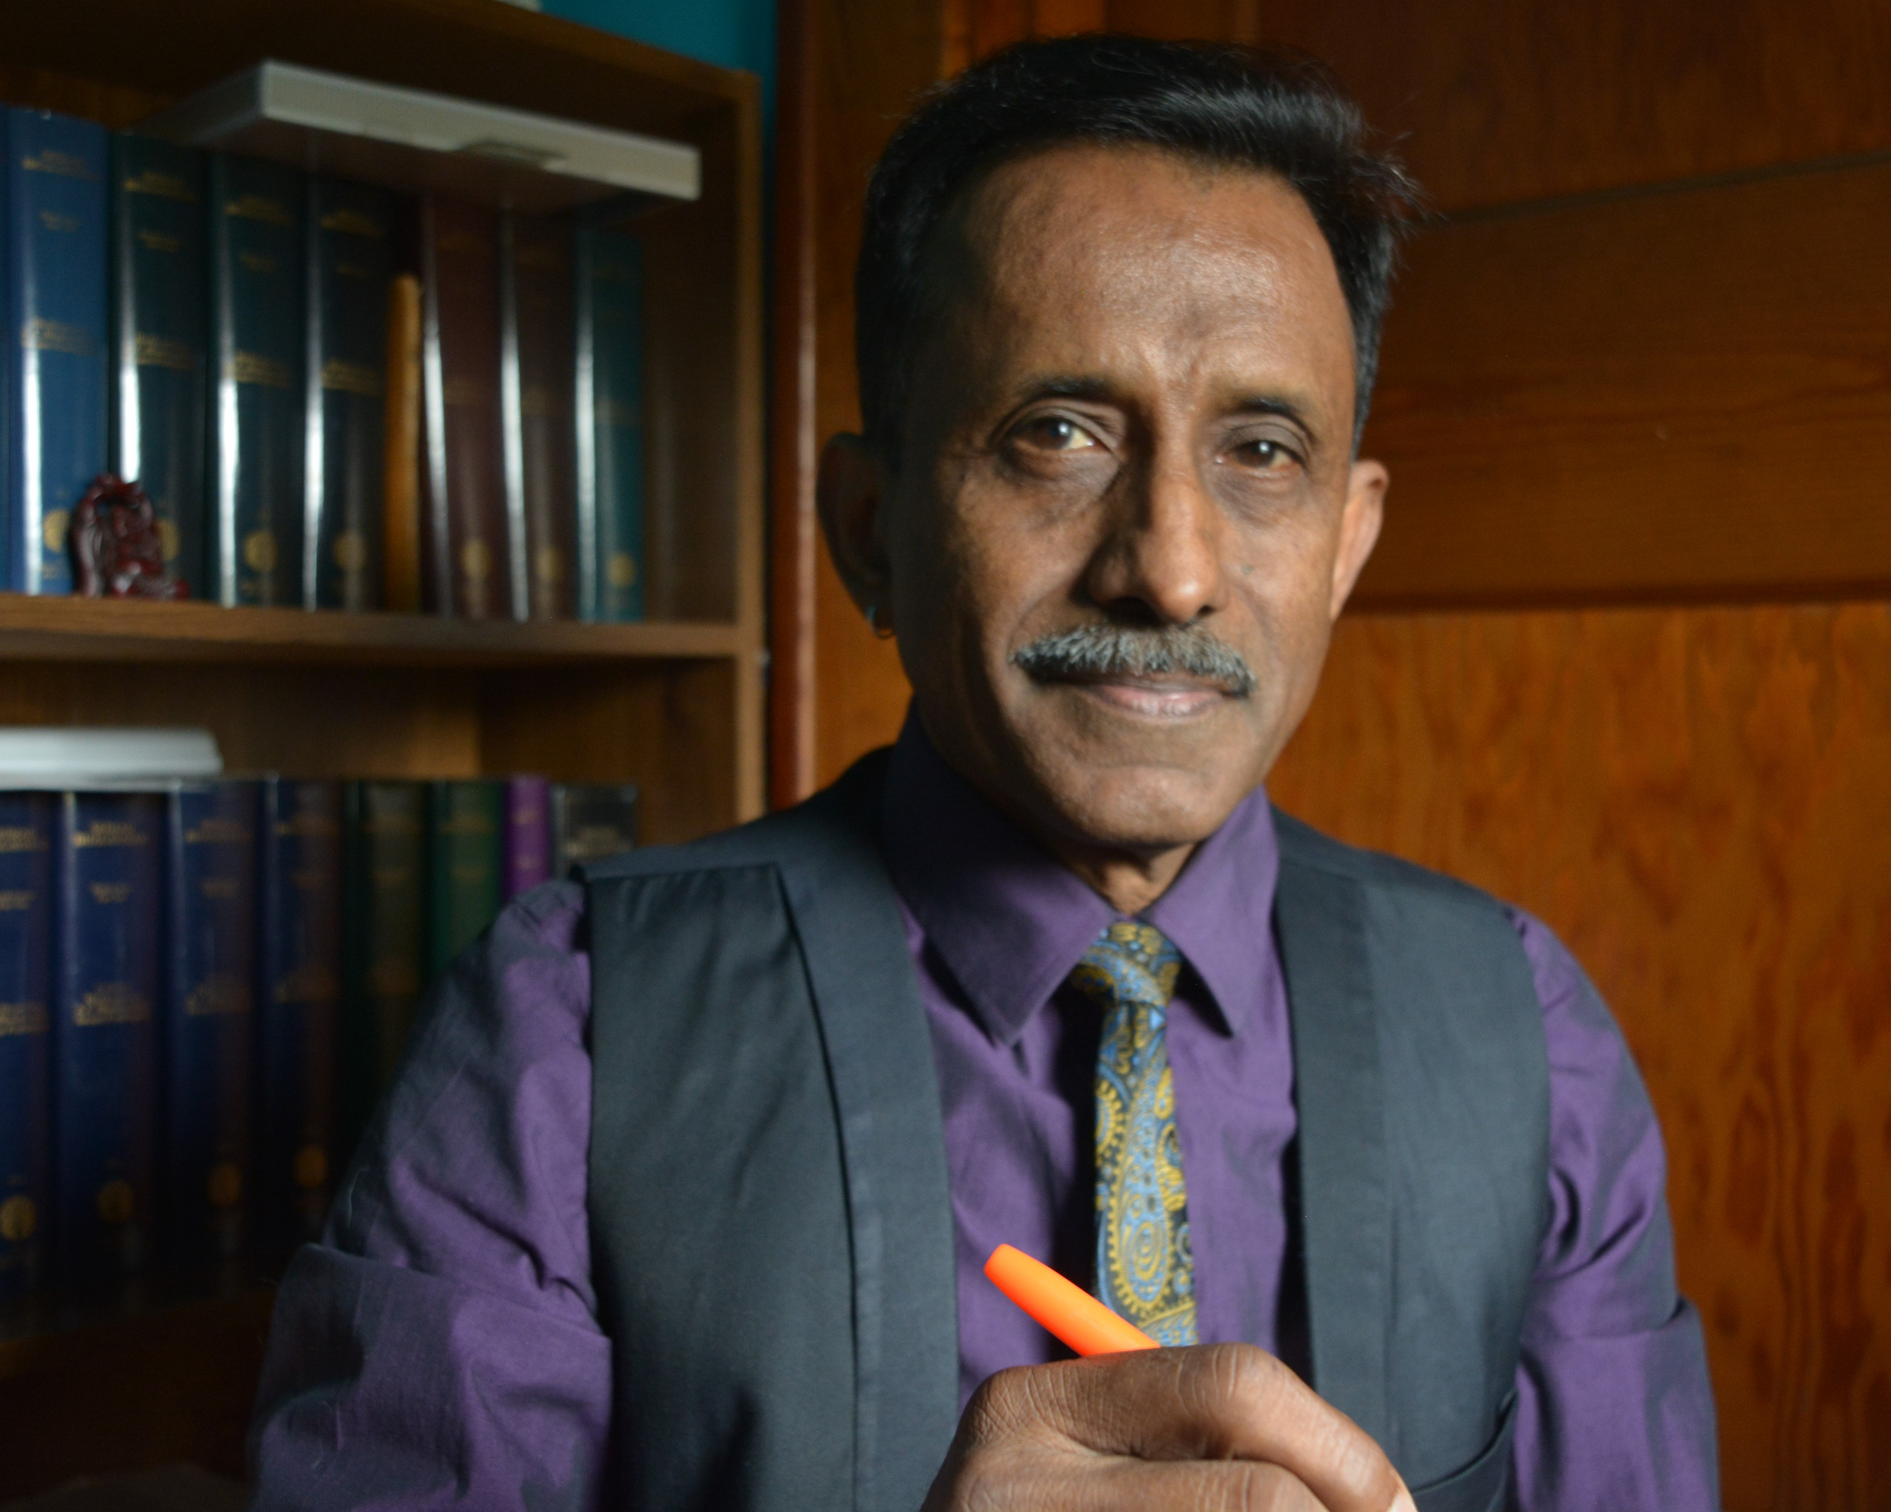
Herman J. Peters Award
Dr. Yegan Pillay

Slide 5
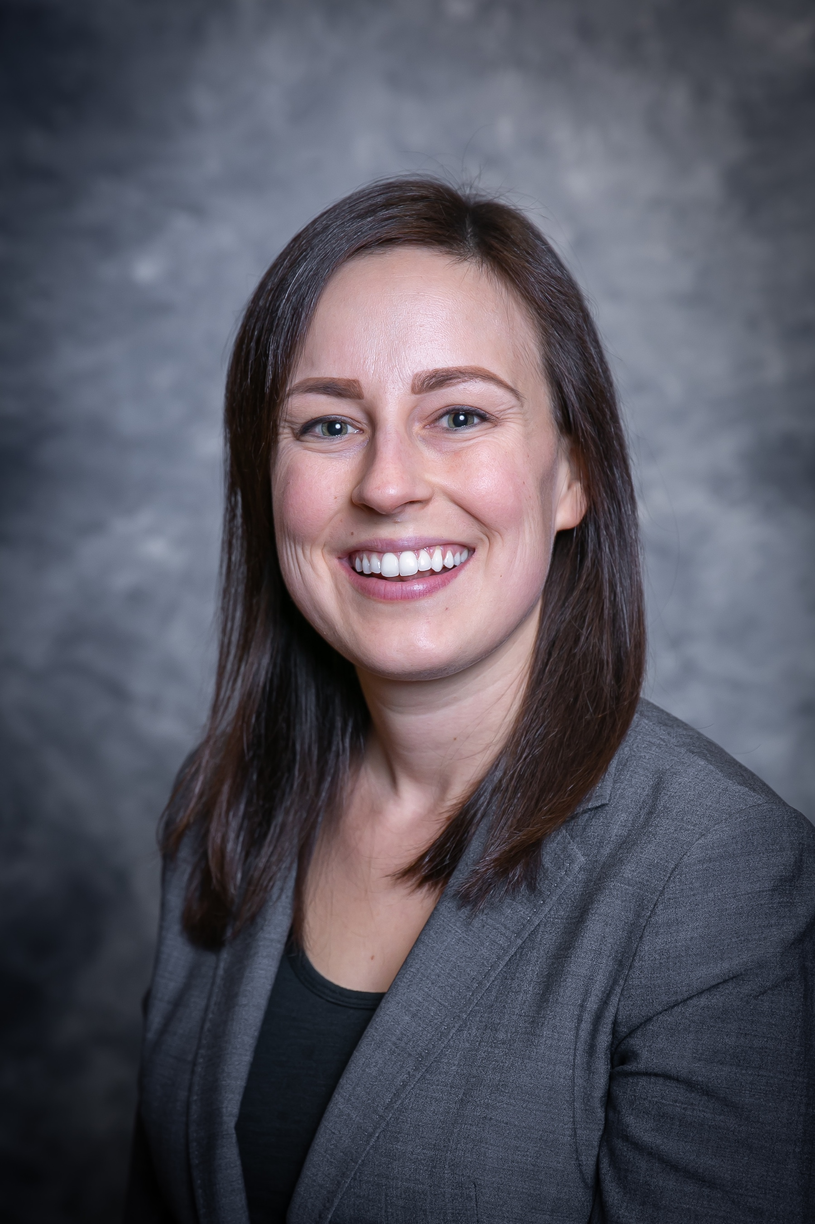
Public Policy and Legislation Award
Dr. Stephanie Drcar

Slide 6
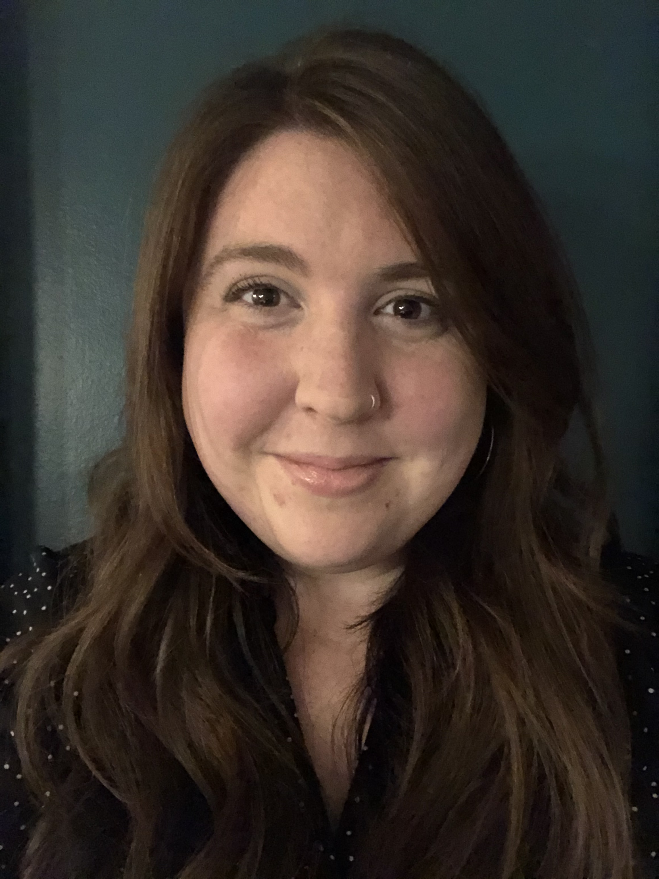
Graduate Student Award
Laura Dunson

Slide 7
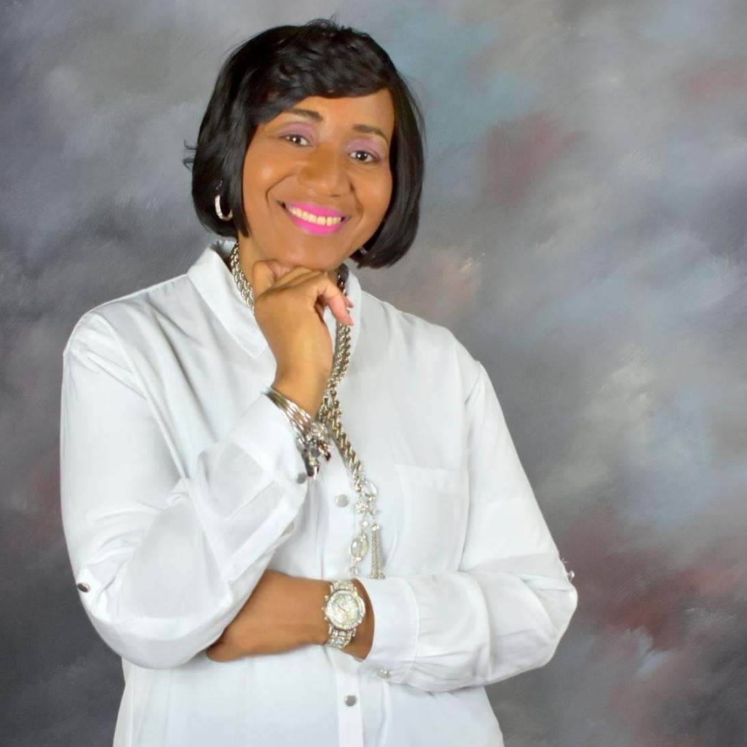
Professional Leadership Award
Dr. Sherdene Simpson

Slide 8
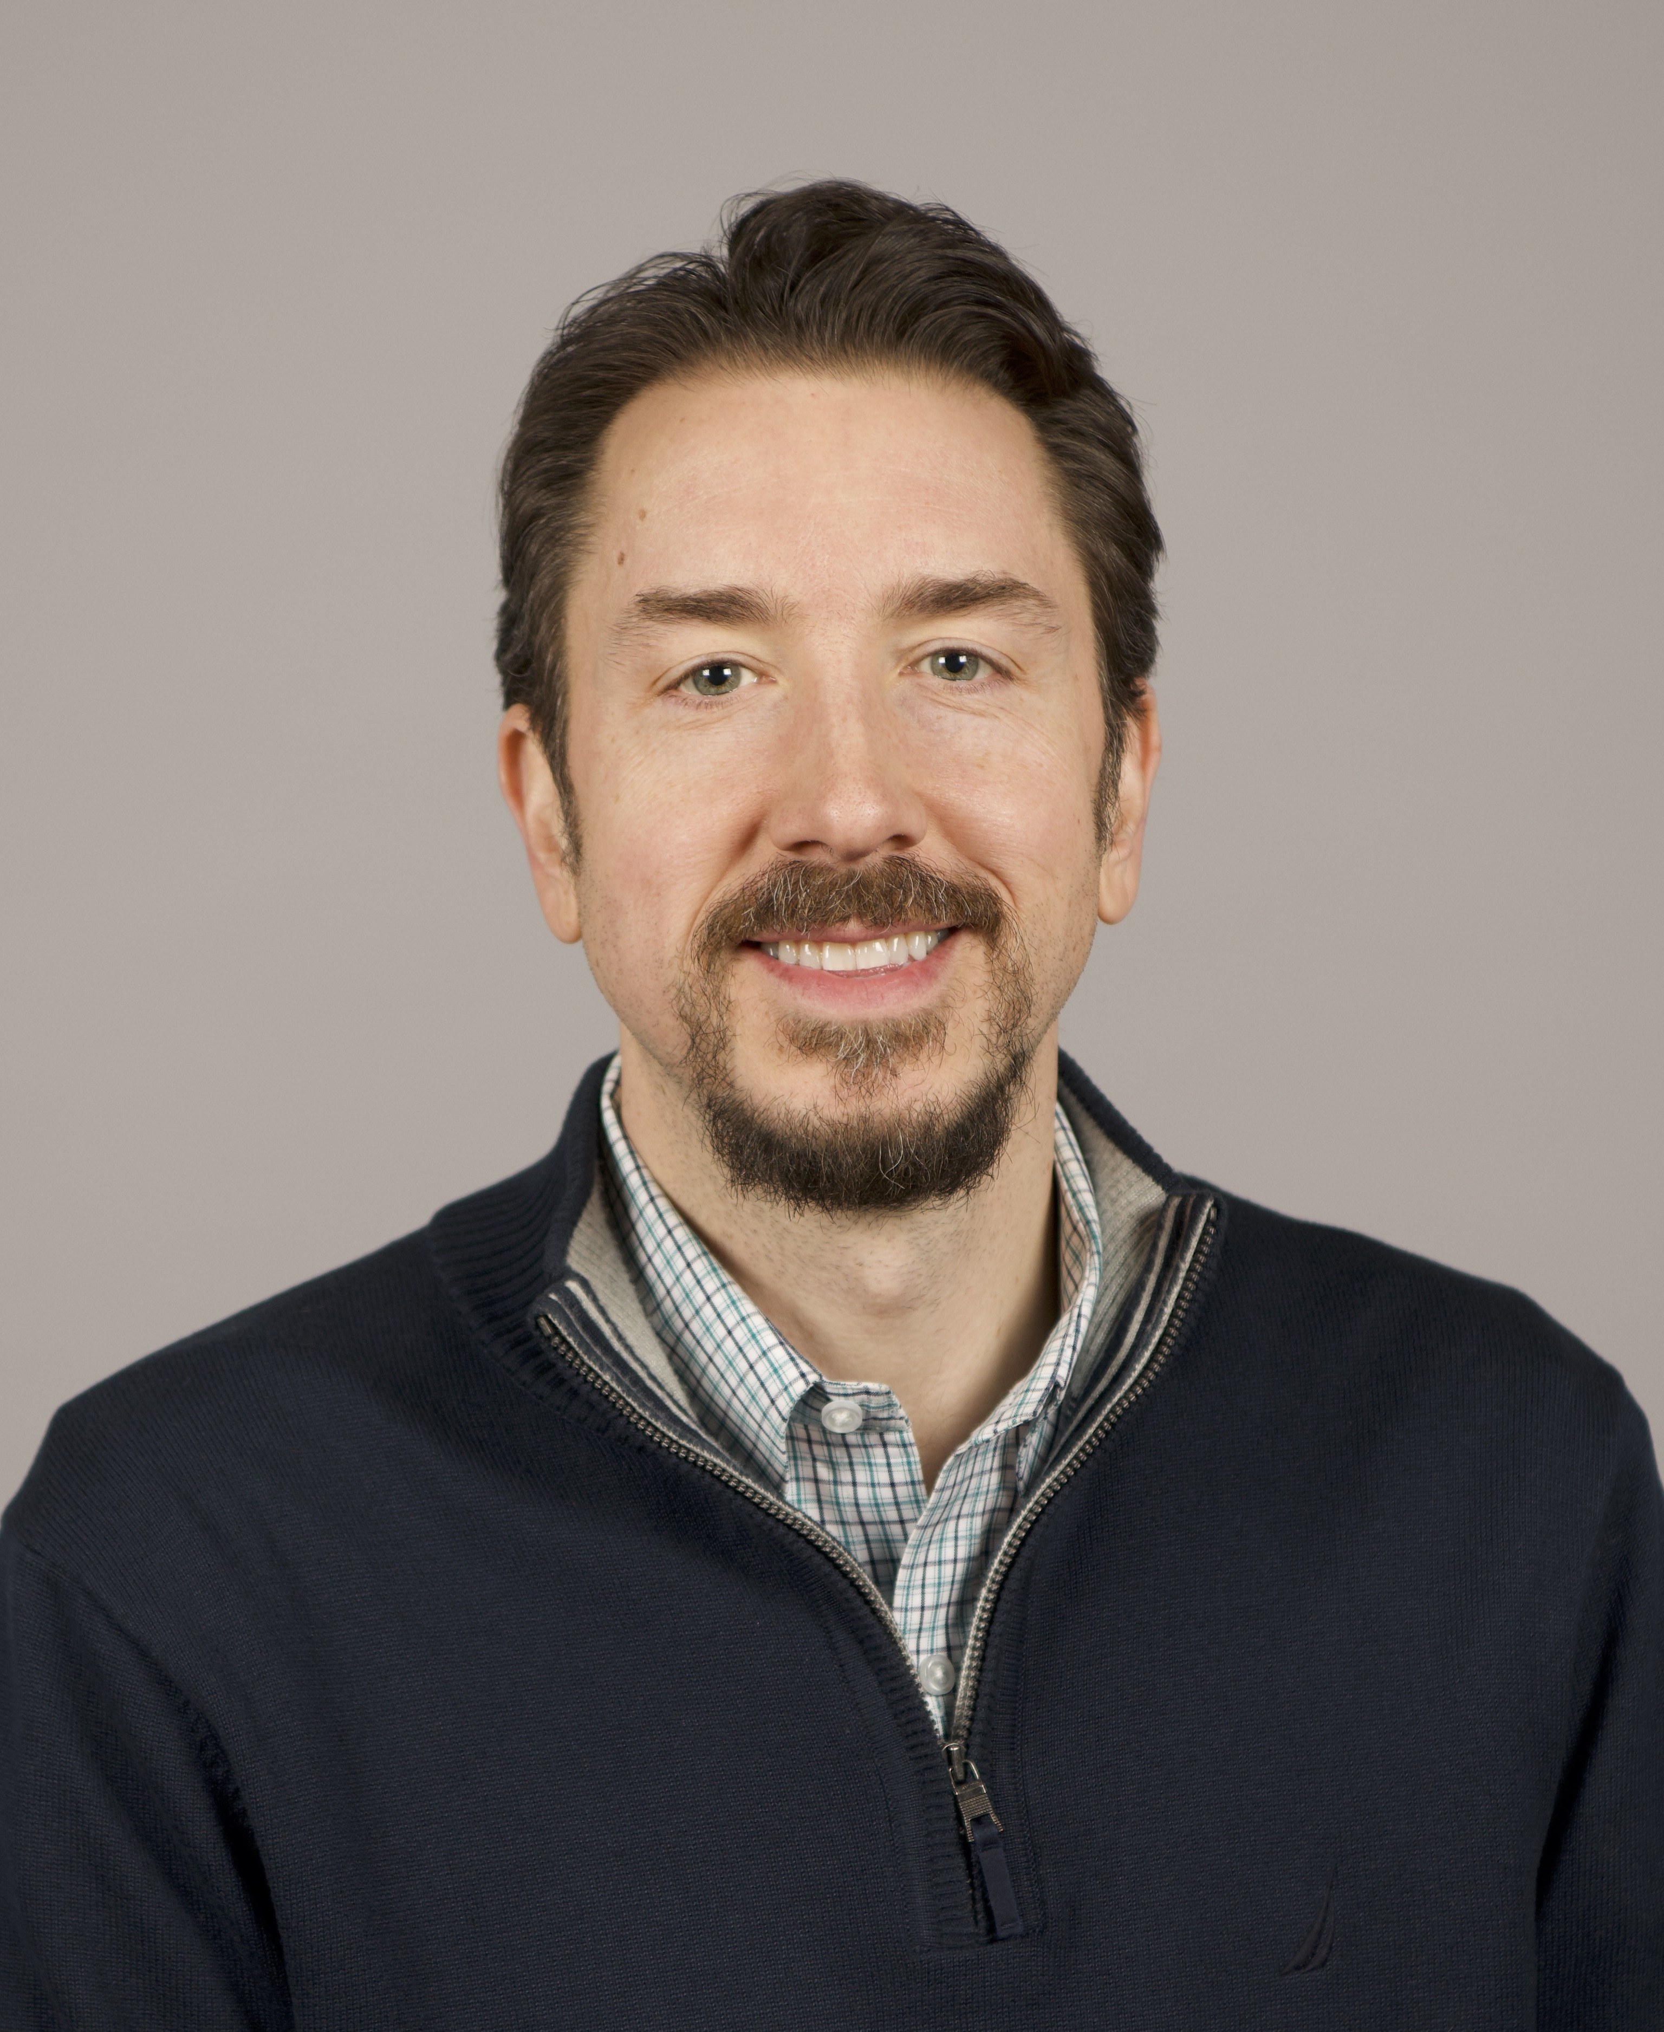
Susan J. Sears Counselor of the Year Award
Dr. Jake Protivnak

Slide 9
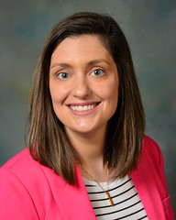
Tom Davis Outstanding Mentoring Award
Dr. Jenna Alvarez

Slide 10
OCA 2022 Awards Ceremony
Thank you for attending!

